Slide 1
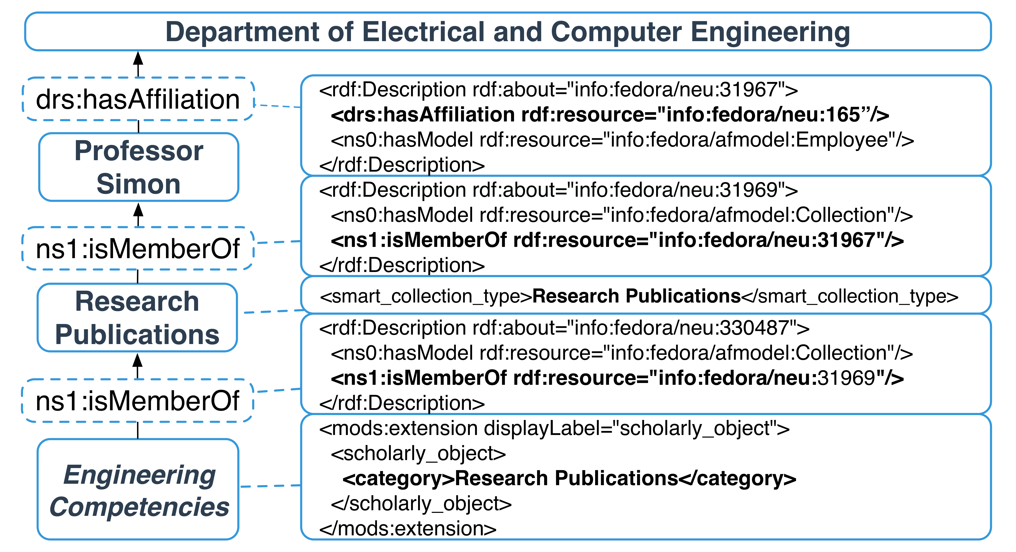
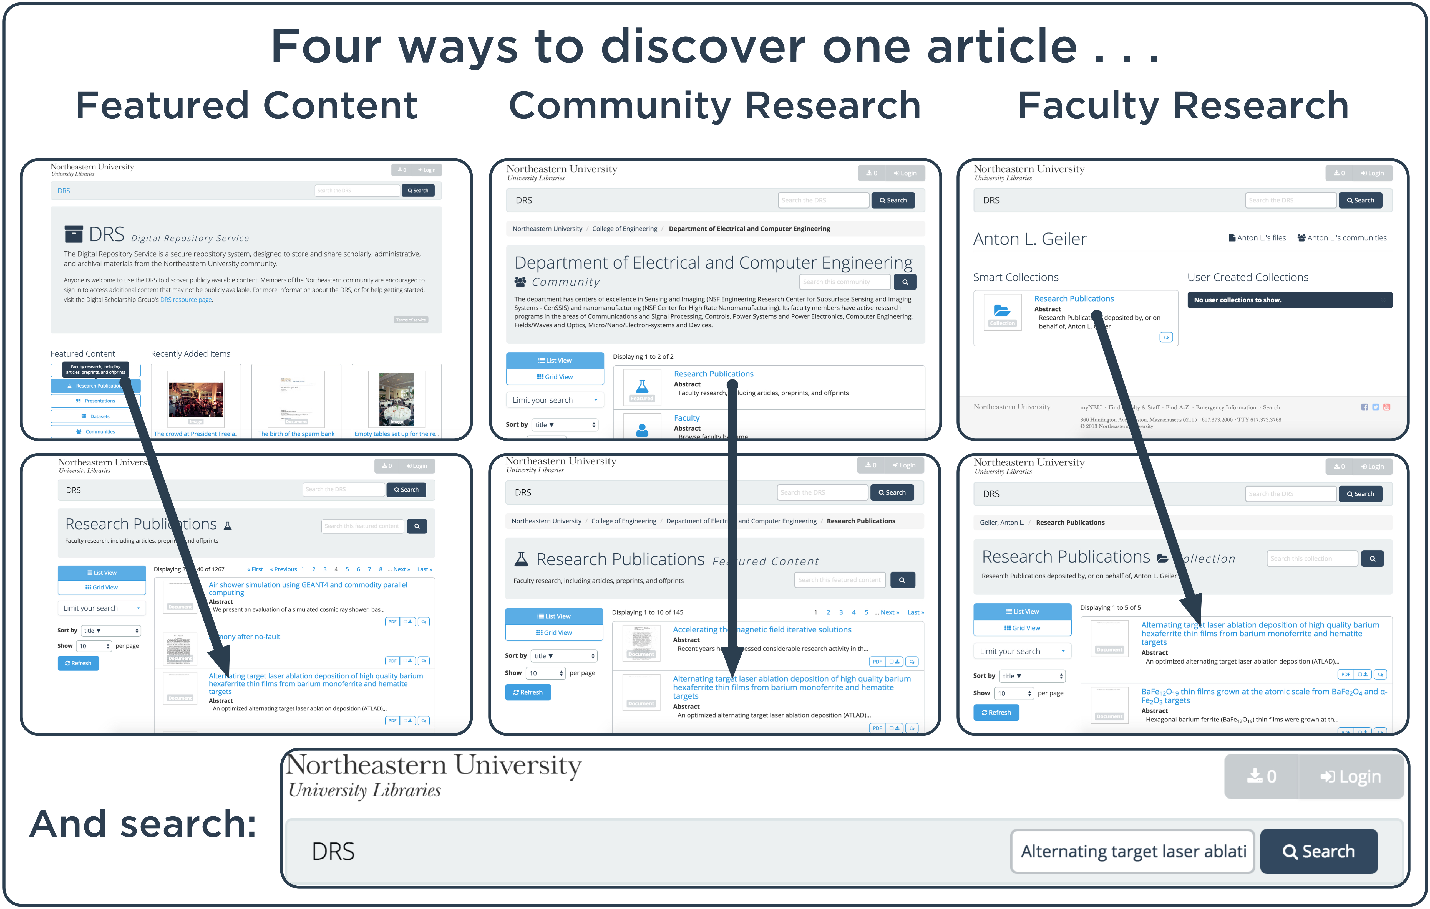

Using Communities to Highlight Scholarly Content in Hydra
Northeastern University Library
Sarah Sweeney sj.sweeney@neu.edu
repository.library.northeastern.edu
The DRS Community Structure
The Digital Repository Service (DRS) was designed to manage and preserve scholarly, administrative, and archival assets created by the Northeastern University community. Early on in the development of the DRS we recognized the need to highlight scholarly objects, primarily faculty-created research publications, presentations, and datasets, and student-created theses and dissertations. In order to distinguish the scholarly content stored in faculty collections from other repository content, we decided to model the DRS collection structure after the Northeastern community structure and create relationships between faculty, their scholarly collections, and their respective NU communities, effectively allowing the repository to query collections for just scholarly content deposited by faculty.
The community framework has not just neatly organized repository content according to the existing Northeastern structure, it has made it easier for the system to leverage the relationships between objects to enhance the discoverability of scholarly content in the repository.
Making the Connection
The DRS uses the relationships between faculty users, Smart Collections, and communities to aggregate content stored in Smart Collections up through the community structure:
Faculty Smart Collections are directly connected to the user with Fedora's predefined <ns1:isMemberOf> statement.
The Hydra properties datastream defines the type of Smart Collection (“Research Publications”).
Faculty are connected to communities using the locally defined <drs:hasAffiliation> RDF statement in the RELS-EXT.
An extension field for scholarly object metadata is included in the descriptive MODS record for each object stored in a Smart Collection (“Research Publications”).
Communities & Smart Collections
The DRS community structure uses three types of compilations to organize content:
Community: A compilation that belongs to the DRS canonical graph. Communities can only contain faculty users, collections, or other communities – it cannot contain files.
Smart Collection: A collection that belongs to a faculty user that is directly connected to the user's community.
Collection: A typical compilation of files.
The top-level Northeastern University community contains communities that represent each school or administrative unit, and each of those communities can contain more communities that represent departments and research groups.
Faculty users are connected to communities, which allows files stored in their Smart Collections to be dynamically represented at the community level, as well.
Homepage Featured Content and community collections that serve up the faculty users' scholarly content are not really collections; they are dynamic aggregations of the content stored in Smart Collections.
Advantages
Valuable repository content can be discovered through multiple search and browse options.
Communities and collections are easily organized according to an existing authoritative framework.
The repository structure follows a model that is quickly understood by Northeastern users.
Disadvantages
The repository structure must be actively maintained as the university evolves.
User education is needed for Smart Collections to be effective.
Learn More
For more information about the DRS visit
dsg.neu.edu/resources/drs or
github.com/NEU-Libraries/cerberus
Notes:
Poster

